Slide 1
ETL Process
Tanzim Hossain
Lecturer

Slide 2
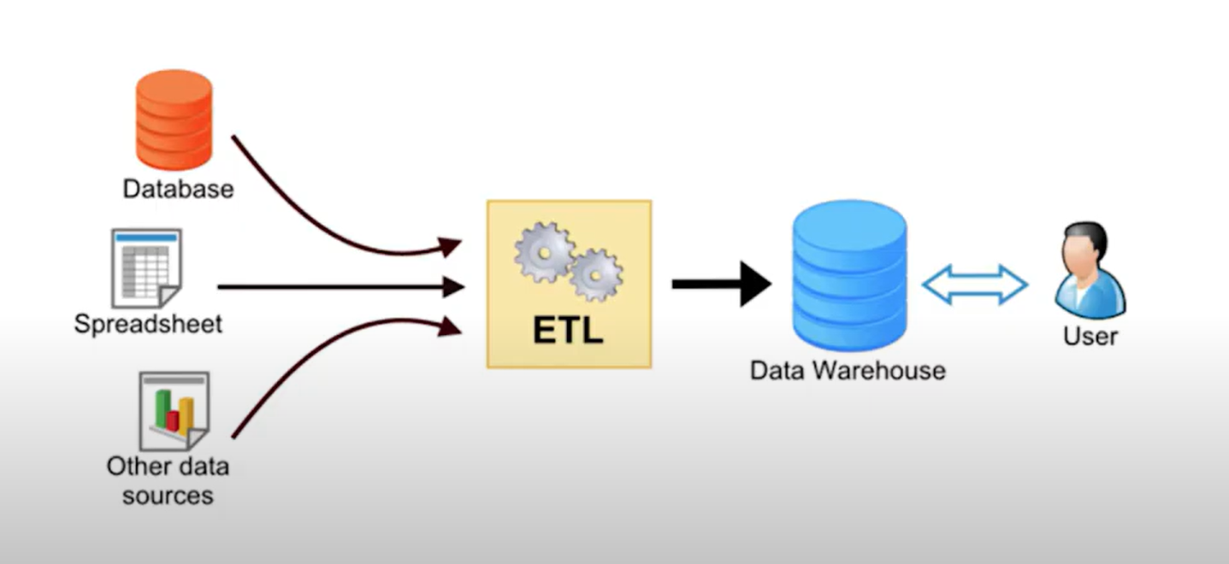
What is ETL?
ETL: Extract - Transform - Load
ETL—meaning extract, transform, load—is a data integration process that combines, cleans and organizes data from multiple sources into a single, consistent data set for storage in a data warehouse, data lake or other target system.

Slide 3
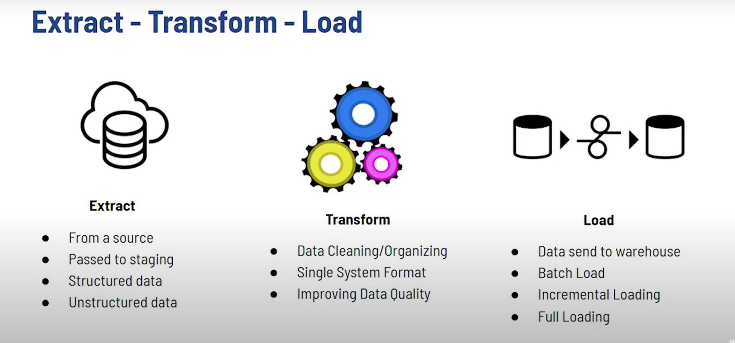
Overview of ETL

Slide 4

ETL Process
- Active Inputs
Developers
Testers
Analysts
Top Executives
- Data Warehouse needs to adapt changes
- Recurring Activity - ETL

Slide 5
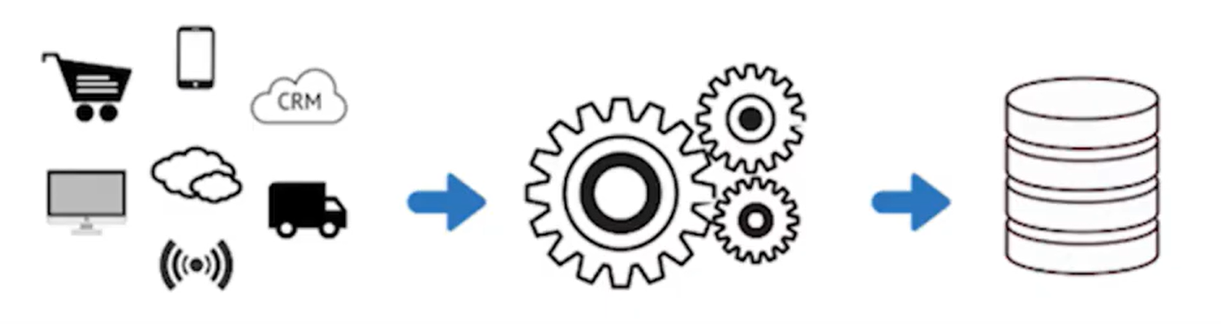
ETL Process- Detailed Explanation
Extraction
- Logical Extraction
- Physical Extraction
Transform
- Filters
- Functions
- Criteria Settings
Load
- Final
- A single clean data

Slide 6
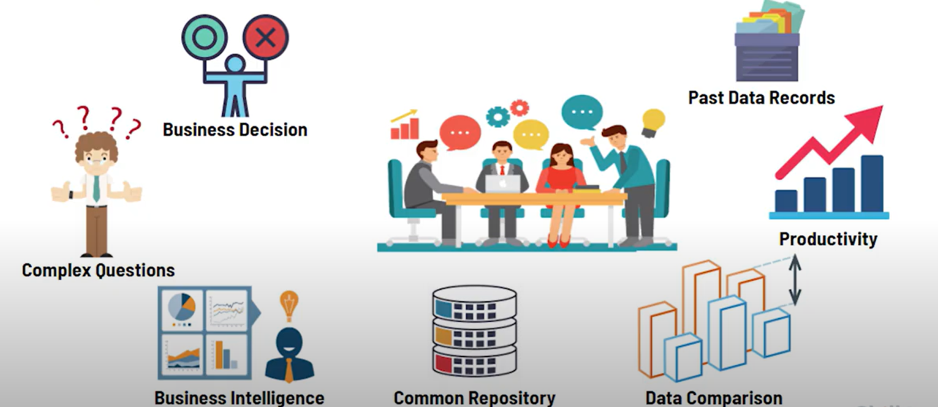
Why we need ETL?

Slide 7
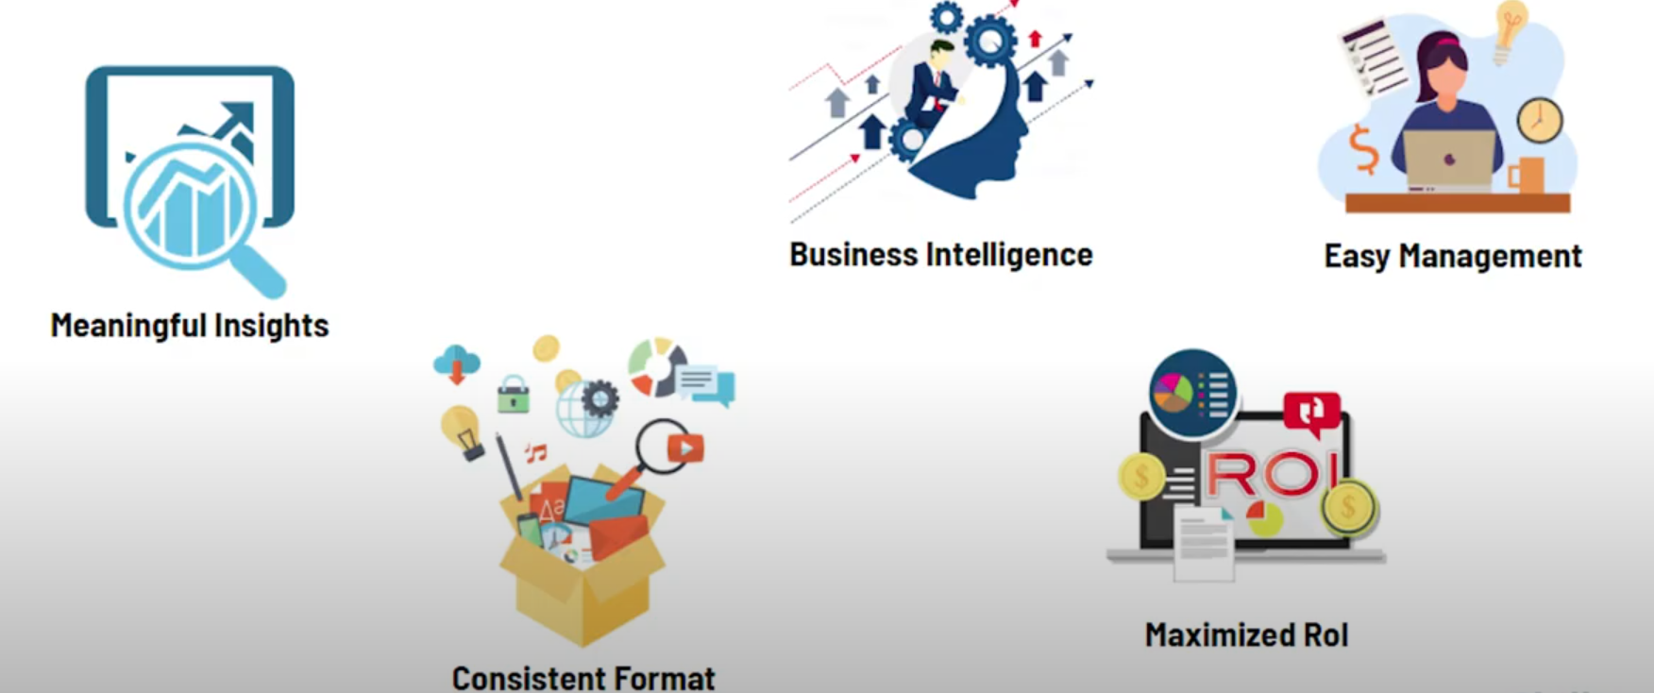
Benefits of ETL?

